Slide 1
Pure Competition in the Short Run
From:
Book 1: Chapter 10

Slide 2
Four Market Models
Pure competition
Pure monopoly
Monopolistic competition
Oligopoly
Oligopoly
Pure
Competition
Monopolistic
Competition
Pure
Monopoly
Market Structure Continuum
LO1

Slide 3
Four Market Models
Characteristics of the Four Basic Market Models
Characteristic | Pure Competition | Monopolistic Competition | Oligopoly | Monopoly
Number of firms | A very large number | Many | Few | One
Type of product | Standardized | Differentiated | Standardized or differentiated | Unique; no close subs.
Control over price | None | Some, but within rather narrow limits | Limited by mutual inter-dependence; considerable with collusion | Considerable
Conditions of entry | Very easy, no obstacles | Relatively easy | Significant obstacles | Blocked
Nonprice Competition | None | Considerable emphasis on advertising, brand names, trademarks | Typically a great deal, particularly with product differentiation | Mostly public relation advertising
Examples | Agriculture | Retail trade, dresses, shoes | Steel, auto, farm implements | Local utilities
LO1

Slide 4
Pure Competition: Characteristics
Very large numbers of sellers
Standardized product
“Price takers”
Easy entry and exit
Perfectly elastic demand
Firm produces as much or little as they want at the price
Demand graphs as horizontal line
LO2
Notes:
A price taker, in economics, refers to a market participant that is not able to dictate the prices in a market. Therefore, a price taker must accept the prevailing market price. A price taker lacks enough market power to influence the prices of goods or services.

Slide 5
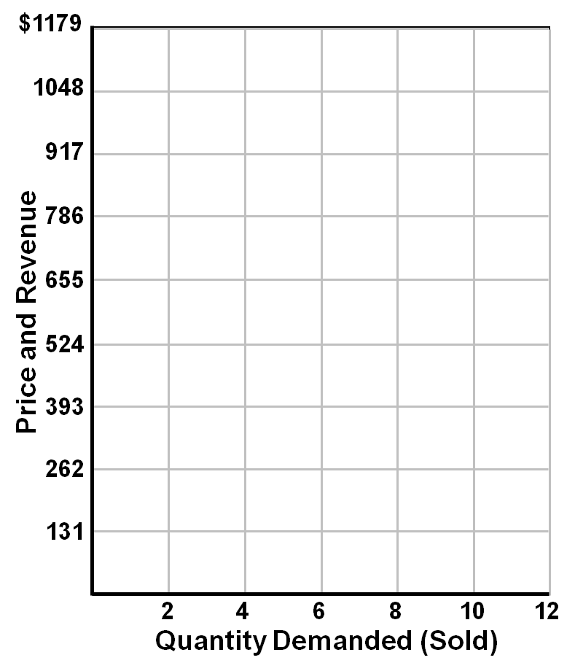
Average, Total, and Marginal Revenue
Firm’s
Demand
Schedule
(Average
Revenue)
Firm’s
Revenue
Data
TR
Q_{D}
P
TR
MR
0
1
2
3
4
5
6
7
8
9
10
$131
131
131
131
131
131
131
131
131
131
131
$0
131
262
393
524
655
786
917
1048
1179
1310
]
$131
131
131
131
131
131
131
131
131
131
]
]
]
]
]
]
]
D = MR = AR
]
]
LO3

Slide 6
Average, Total, and Marginal Revenue
Average Revenue
Revenue per unit
AR = TR/Q = P
Total Revenue
TR = P X Q
Marginal Revenue
Extra revenue from 1 more unit
MR = ΔTR/ΔQ
LO3

Slide 7
Profit Maximization: TR–TC Approach
Three questions:
Should the firm produce?
If so, what amount?
What economic profit (loss) will be realized?
LO3

Slide 8
Profit Maximization: TR–TC Approach
The Profit-Maximizing Output for a Purely Competitive Firm: Total Revenue – Total Cost Approach (Price = $131)
(1) Total Product (Output) (Q) | (2) Total Fixed Cost (TFC) | (3) Total Variable Costs (TVC) | (4) Total Cost (TC) | (5) Total Revenue (TR) | (6) Profit (+) or Loss (-)
0 | $100 | $0 | $100 | $0 | $-100
1 | 100 | 90 | 190 | 131 | -59
2 | 100 | 170 | 270 | 262 | -8
3 | 100 | 240 | 340 | 393 | +53
4 | 100 | 300 | 400 | 524 | +124
5 | 100 | 370 | 470 | 655 | +185
6 | 100 | 450 | 550 | 786 | +236
7 | 100 | 540 | 640 | 917 | +277
8 | 100 | 650 | 750 | 1048 | +298
9 | 100 | 780 | 880 | 1179 | +299
10 | 100 | 930 | 1030 | 1310 | +280
LO3

Slide 9
Profit Maximization: TR–TC Approach
$1800
1700
1600
1500
1400
1300
1200
1100
1000
900
800
700
600
500
400
300
200
100
Break-Even Point
(Normal Profit)
Total Revenue, (TR)
Maximum
Economic
Profit
$299
Total Cost,
(TC)
Total Revenue and Total Cost
P=$131
Break-Even Point
(Normal Profit)
0
1
2
3
4
5
6
7
8
9
10
11
12
13
14
Quantity Demanded (Sold)
$500
400
300
200
100
Total Economic
Profit
$299
Total Economic
Profit
0
1
2
3
4
5
6
7
8
9
10
11
12
13
14
Quantity Demanded (Sold)
LO3

Slide 10
Profit Maximization: MR-MC Approach
The Profit-Maximizing Output for a Purely Competitive Firm: Marginal Revenue – Marginal Cost Approach (Price = $131)
(1) Total Product (Output) | (2) Average Fixed Cost (AFC) | (3) Average Variable Costs (AVC) | (4) Average Total Cost (ATC) | (5) Marginal Cost (MC) | (5) Price = Marginal Revenue (MR) | (6) Total Economic Profit (+) or Loss (-)
0 |  |  |  |  |  | $-100
1 | $100.00 | $90.00 | $190 | $90 | $131 | -59
2 | 50.00 | 85.00 | 135 | 80 | 131 | -8
3 | 33.33 | 80.00 | 113.33 | 70 | 131 | +53
4 | 25.00 | 75.00 | 100.00 | 60 | 131 | +124
5 | 20.00 | 74.00 | 94.00 | 70 | 131 | +185
6 | 16.67 | 75.00 | 91.67 | 80 | 131 | +236
7 | 14.29 | 77.14 | 91.43 | 90 | 131 | +277
8 | 12.50 | 81.25 | 93.75 | 110 | 131 | +298
9 | 11.11 | 86.67 | 97.78 | 130 | 131 | +299
10 | 10.00 | 93.00 | 103.00 | 150 | 131 | +280
LO3

Slide 11
Profit Maximization: MR-MC Approach
$200
MR = MC
MC
150
P=$131
Economic Profit
MR = P
Cost and Revenue
ATC
100
AVC
A=$97.78
50
0
1
2
3
4
5
6
7
8
9
10
Output
LO3

Slide 12
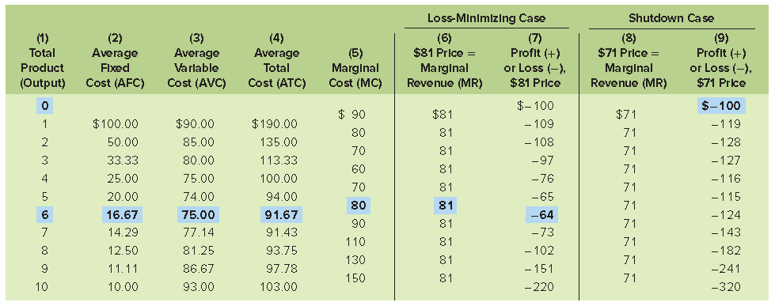
Loss-Minimizing Case
LO3

Slide 13
Loss-Minimizing Case
Loss minimization
Still produce because P > minAVC
Losses at a minimum where MR=MC
LO3

Slide 14
Loss-Minimizing Case
$200
150
MC
Loss
A=$91.67
ATC
Cost and Revenue
100
AVC
P=$81
MR = P
50
V = $75
0
1
2
3
4
5
6
7
8
9
10
Output
LO3

Slide 15
Shutdown Case
$200
150
MC
ATC
Cost and Revenue
V = $74
100
AVC
P=$71
MR = P
Short-Run Shut Down Point
P < Minimum AVC
$71 < $74
50
0
1
2
3
4
5
6
7
8
9
10
Output
LO3

Slide 16
Three Production Questions
Output Determination in Pure Competition in the Short Run
Question | Answer
Should this firm produce? | Yes, if price is equal to, or greater than, minimum average variable cost. This means that the firm is profitable or that its losses are less than its fixed cost.
What quantity should this firm produce? | Produce where MR (=P) = MC; there, profit is maximized (TR exceeds TC by a maximum amount) or loss is minimized.
Will production result in economic profit? | Yes, if price exceeds average total cost (TR will exceed TC). No, if average total cost exceeds price (TC will exceed TR).
LO3

